Slide 1
Home Brewing
with Python
coldeasy@gmail.com
cdeasy@demonware.net
Notes:
Both complement each other

Slide 2
Why
1) Home brewing is mainly manual
2) Error prone, lots of little things can create off-flavours
3) Lack of control
4) Lack of visibility on progress
Notes:
A steady rate of fermentation is necessary during primary fermentation. This can be achieved by having an airtight chamber and a constant temperature.
It’s difficult to tell what stage the fermentation is at without taking a hydrometric reading.

Slide 3
General Architecture
Raspberry PI Arch (+modules wire, w1_gpio, w1_therm), systemd, python
Simple circuit boards for controlling/reading temperature using GPIO pins.
Interfaced with using python RPIO lib
Metrics collection service on server (+graphite/carbon)
Web interface for storing brew logs and linking to metrics
Notes:
tornado, storm, nginx
Signed metrics (overkill?)
Storing brew logs is quite important in order to realise past mistakes that may have interferred with the taste of the beer.

Slide 4
Monitoring fermenting temperature
Uses a 1-wire interface thermometer which gives Celsius readings to 5 s.f.
For every reading (0.2s-1) a metric is sent to the server.
A controller turns on/off pump/heater based on these readings.

Slide 5
Controlling temperature
Heats external water supply and pumps it through copper coils
Bought a few cheap components but all failed within 1 week (overuse? lesson #1)
The pump now has max execution times and lapse times to prevent overheating
There is a critical range, outside of which alarms are sent to notify relevant people to fix the brew (Don't spam people, lesson #2)
Notes:
- Twilio costs! Texts from US to Ireland ain't cheap and you can drain
you're account quickly. 3 a.m. me and my fiance were spammed continually every
5 seconds. It took me about 5-10 minutes to get up and fix the temperature. 40
Euro sunk in those few minutes. Plus an angry Fiance.
- No exponential backoff! ☺
- Software reliability (in simple systems at least) seems easier than
hardware reliability. At least in terms of impact. There is not a lot you can
do when hardware fails other than waiting for a new part to come. With
software, generally you can make a quick fix.

Slide 6
Recording metrics/progress
- Signed Metrics sent plain over UDP
- Server proxies to carbon
- Viewed on graphite
- Simple web interface to store brew logs and view metrics

Slide 7
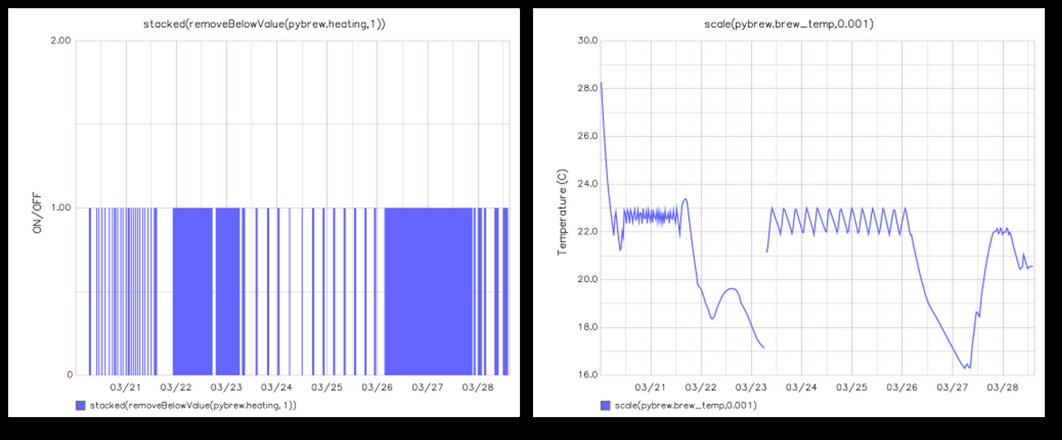

Slide 8
Monitoring rate of fermentation
- Used both optical mouse and photo-interrupter (IR emitter/detector) with less than great results
- Mouse sensor only detected 'large' continuous (~500ms) bubbles
- Photo-interrupter worked mostly OK
- #1 problem was co2 expulsion outside of airlock.
- #2 problem is that emissions are not a very accurate representation of fermentation.
Notes:
Infrequent bubble emissions.

Slide 9
Future plans
- More reliable hardware (heating element, pump)
- Airtight fermentation bucket
- Better measurement of fermentation:
- prevent co2 escaping outside of airlock?
- Density?
- Upward pressure within the brew?
- Digital hydrometer?
Notes:
TODO explain “upward pressure within the brew”

